Slide 1
Chapter 07
Asynchronous Machines
(Induction machines)

Slide 2
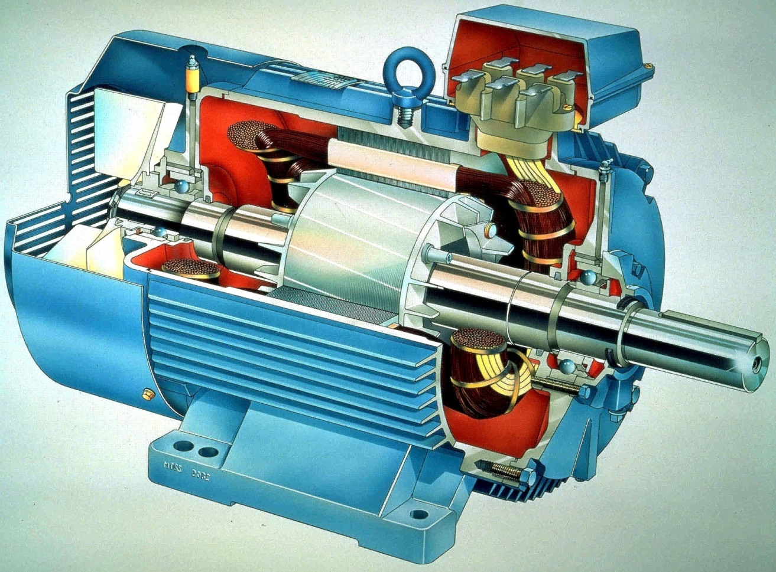
Introduction
Structure
  Stator: similar to
  synchronous machines
  Rotor:
    Wound rotor
    Squirrel cage rotor
Trịnh Hoàng Hơn
ICA Lab

Slide 3
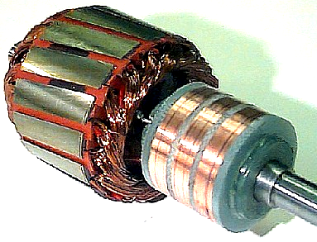
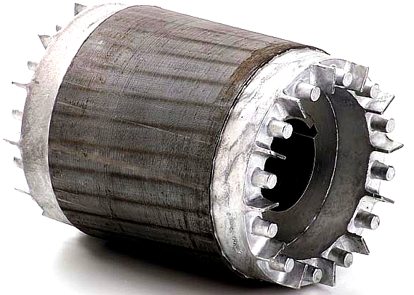
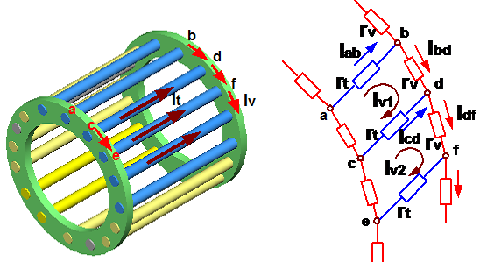
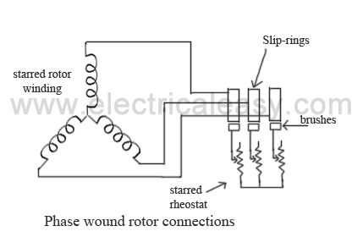
Introduction
Wound rotor and Squirrel cage rotor
Trịnh Hoàng Hơn
ICA Lab

Slide 4
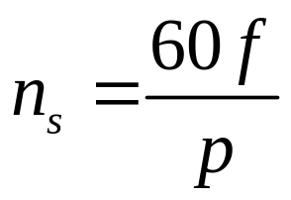
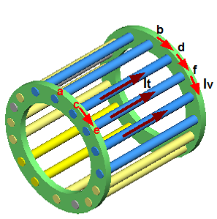
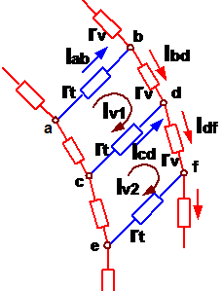
Principles of operation
Call n_{act} is speed of rotor
  N_{act}=0
4 poles (p=2) of
stator windings
6 poles (p=3) of
stator windings
Stator’s rotating field revolves
Flux of each rotor’s frame is time-varying
Secondary flux field is generated
at rotor’s frames
Opposite polarity
Rotor revolves
Trịnh Hoàng Hơn
ICA Lab

Slide 5
Principles of operation
Call n_{act} is speed of rotor
  N_{act}=n_{s}
Stator’s rotating field revolves
Flux of each rotor’s frame is time-varying
Secondary flux field is generated
at rotor’s frames
No!
Opposite polarity
Rotor revolves
Trịnh Hoàng Hơn
ICA Lab

Slide 6
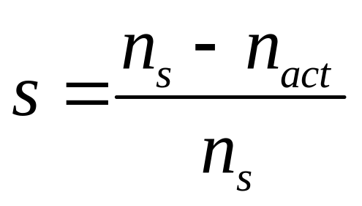
Principles of operation
Finally,
  n_{act}<n_{s},→ “Asynchronous machine”
(1)
S: slip term
N_{s}: synchronous speed
N_{act}: rotor speed
Trịnh Hoàng Hơn
ICA Lab

Slide 7
Quantitative analysis
Rotating machines

Slide 8
Electro-mechanical systems
Transformers
Synchronous machine
Asynchronous machine
DC machine
Objects
Step 01
Linkage
flux λ_{i}
Voltage
equations v_{i}
Review simple examples
Rotational system
Translational system
Static system
Step 02
Step 05
Energy or
co-energy
Equivalent
voltage equations
Step 03
Step 06
Force and torque
(electrical origin)
Electrical
equivalent circuits
Step 04
Step 07
Conclusion
Analysis and determination of systems

Slide 9
Three-phase
Induction machine

Slide 10
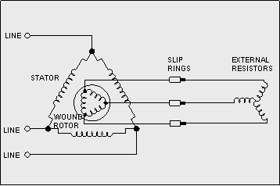
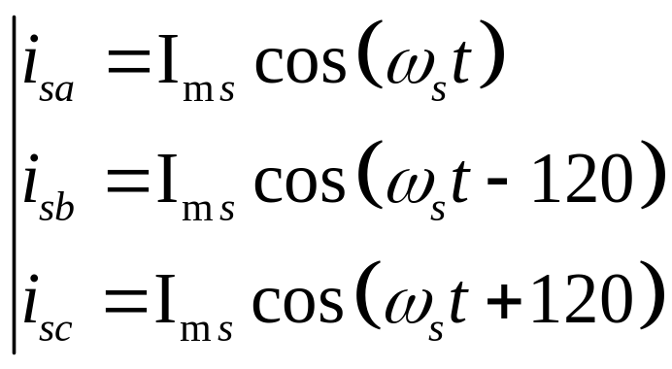
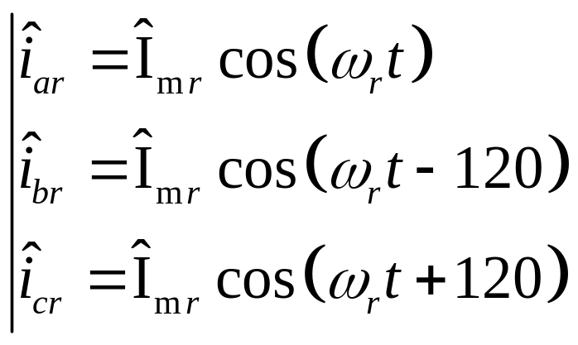
Three-phase induction machines – step 1,2,3
6 electrical ports
1 mechanical port
  Rotor rotates: T^{e}, θ
(2)
(3)
Trịnh Hoàng Hơn
ICA Lab

Slide 11
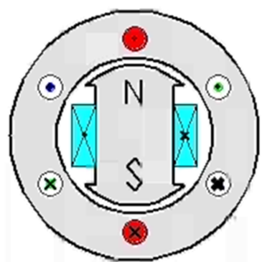
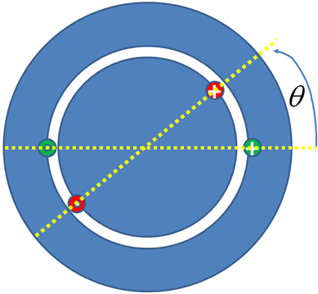
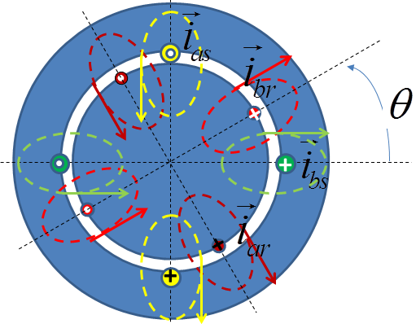
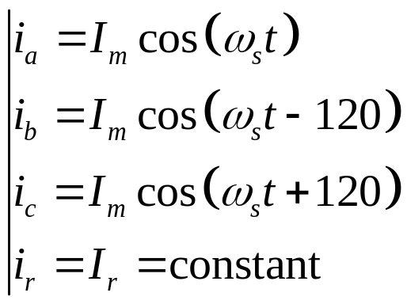
Step 1: Three-phase asynchronous machine
Single phase machine
Two phase machine
12 areas for asynchronous machine
Trịnh Hoàng Hơn
ICA Lab

Slide 12
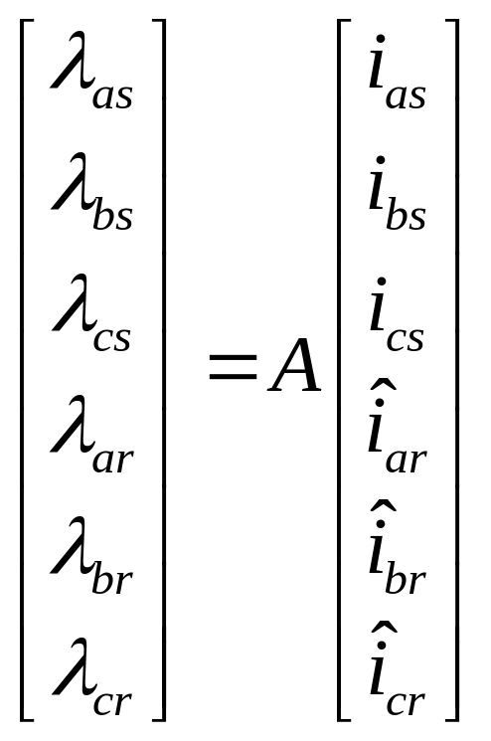
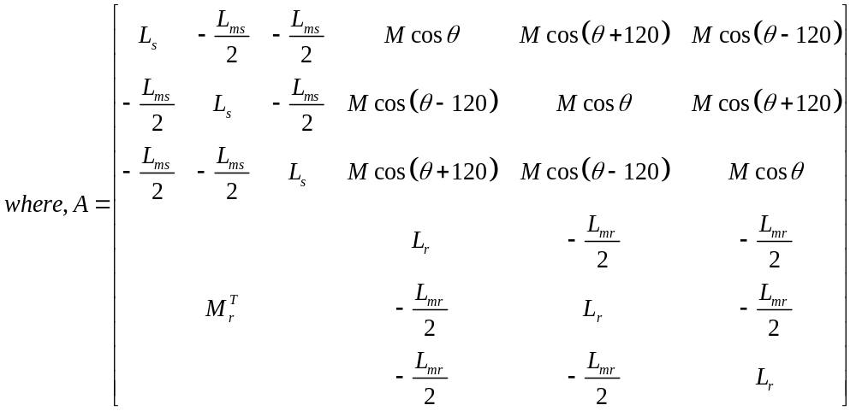
Three-phase induction machines
Linkage flux
(4)
(5)
Trịnh Hoàng Hơn
ICA Lab

Slide 13
Three-phase induction machines
Linkage flux
(4)
(5)
Trịnh Hoàng Hơn
ICA Lab

Slide 14
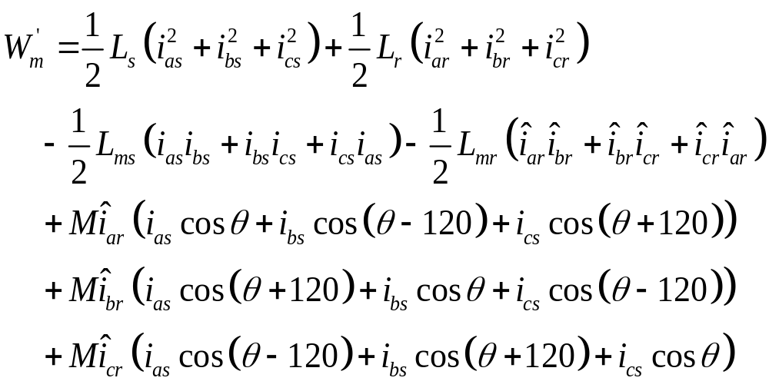
Step 2- Three-phase induction machines
Oh my God!
Learned by heart to die?
Co-energy
(6)
Trịnh Hoàng Hơn
ICA Lab

Slide 15
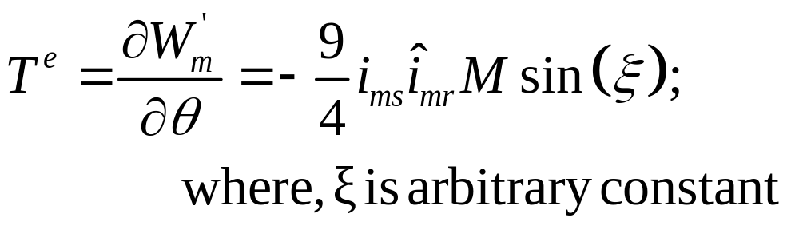
Step 3 -Three-phase induction machines
Torque of electric origin
(7)
Trịnh Hoàng Hơn
ICA Lab

Slide 16
Electro-mechanical systems
Transformers
Synchronous machine
Asynchronous machine
DC machine
Objects
Step 01
Linkage
flux λ_{i}
Voltage
equations v_{i}
Review simple examples
Rotational system
Translational system
Static system
Step 02
Step 05
Energy or
co-energy
Equivalent
voltage equations
Step 03
Step 06
Force and torque
(electrical origin)
Electrical
equivalent circuits
Step 04
Step 07
Conclusion
Analysis and determination of systems

Slide 17
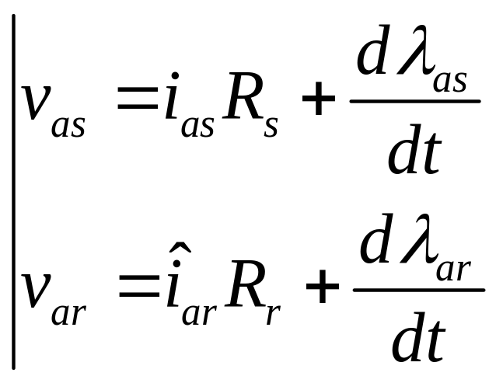
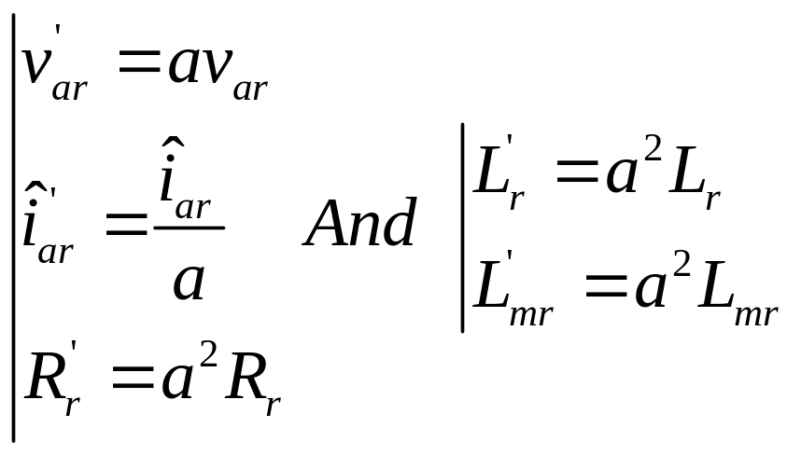
Three-phase induction machines
Voltage equations
Equivalent Equations
(8)
(9)
Rules as
for transforing
Trịnh Hoàng Hơn
ICA Lab

Slide 18
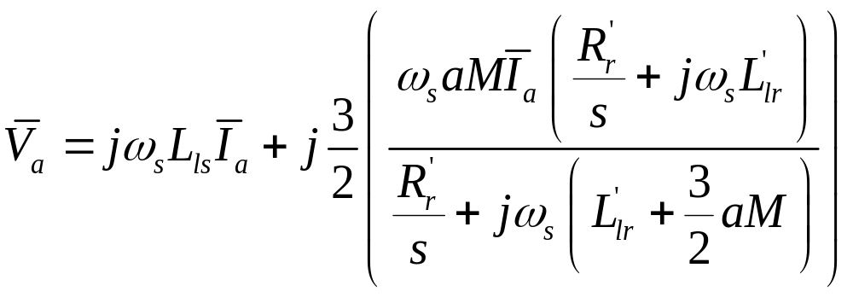






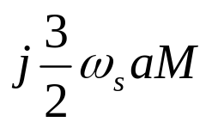
Three-phase induction machines
Equivalent equations
Equivalent circuit
(10)
Trịnh Hoàng Hơn
ICA Lab

Slide 19
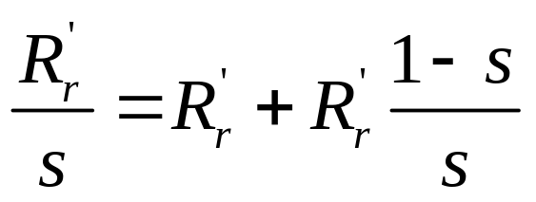
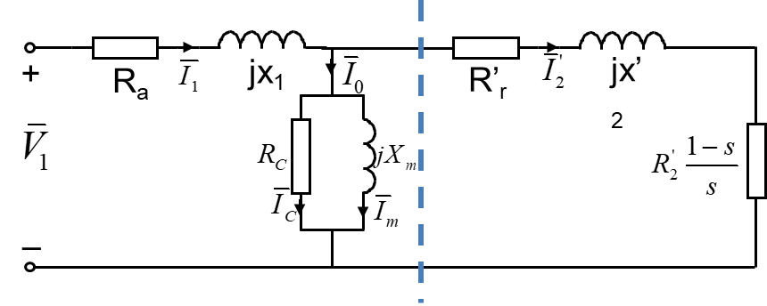
Three-phase induction machines
Equivalent equations
Equivalent circuit
(10)
Trịnh Hoàng Hơn
ICA Lab

Slide 20



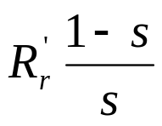
Three-phase induction machines
Equivalent circuits
  Approximate equivalent circuit
(11)
Trịnh Hoàng Hơn
ICA Lab

Slide 21







Three-phase induction machines
Equivalent circuits
  Core and stator losses can be accounted
Trịnh Hoàng Hơn
ICA Lab

Slide 22
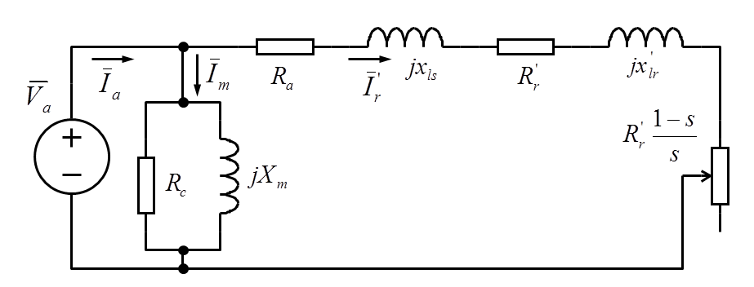
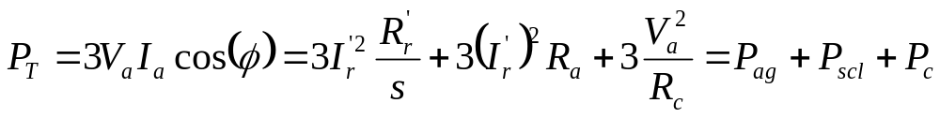
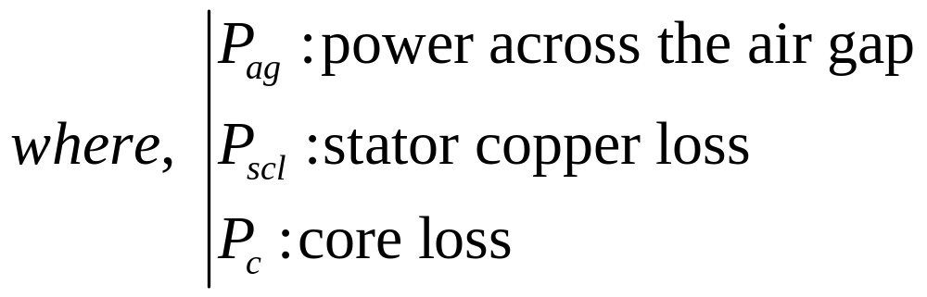
Three-phase induction machines
Power relationships
(12)
Trịnh Hoàng Hơn
ICA Lab

Slide 23
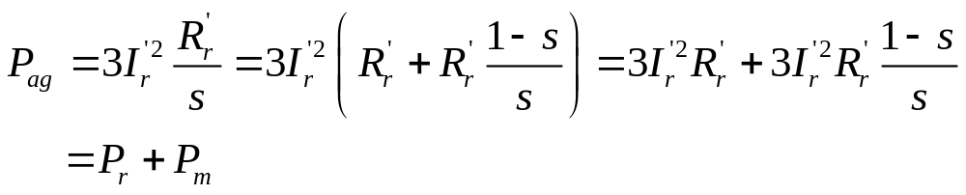
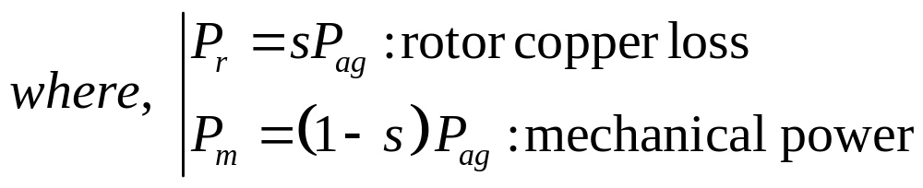
Three-phase induction machines
Power relationships
(13)
(14)
Trịnh Hoàng Hơn
ICA Lab

Slide 24
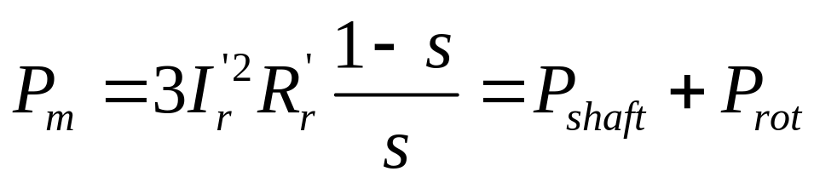
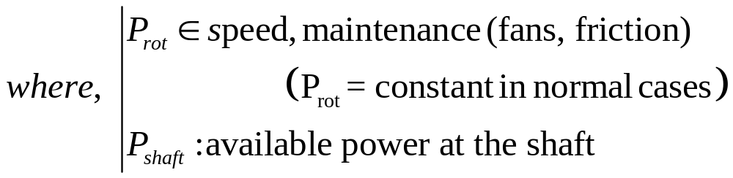
Three-phase induction machines
Power relationships
(15)
Trịnh Hoàng Hơn
ICA Lab

Slide 25
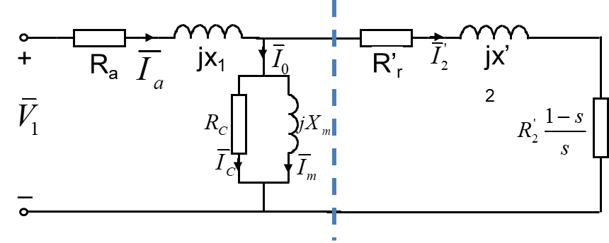
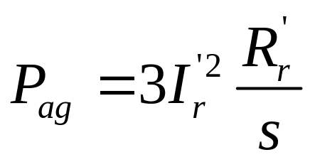
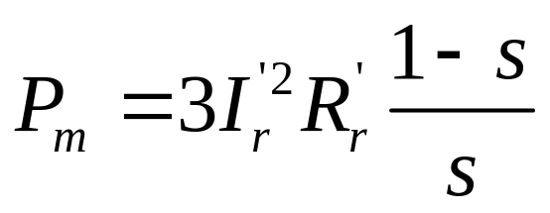
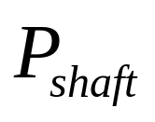
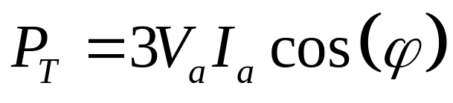
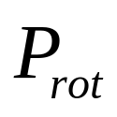
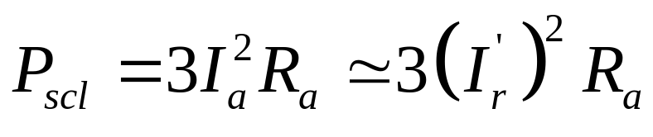
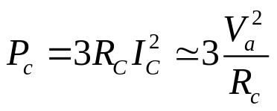
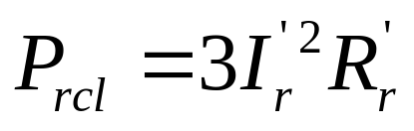
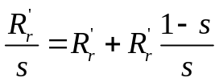
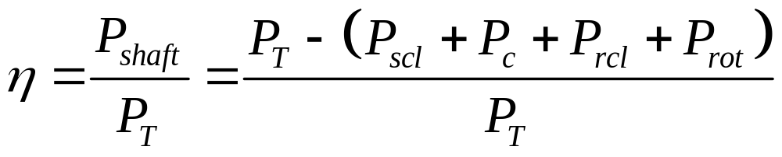
Three-phase induction machines
Power relationships
Efficiency
(16)
Trịnh Hoàng Hơn
ICA Lab

Slide 26
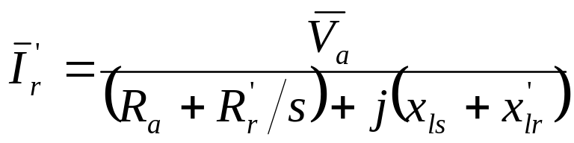
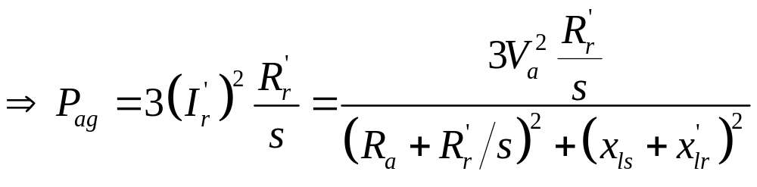
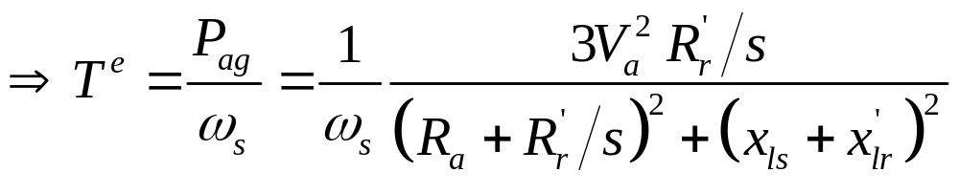
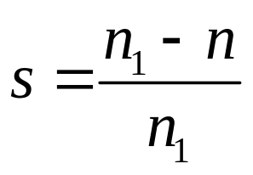
Three-phase induction machines
Expression for T^{e} in terms of V_{a}
  Using approximate equivalent circuit
(17)
(18)
(19)
Trịnh Hoàng Hơn
ICA Lab

Slide 27
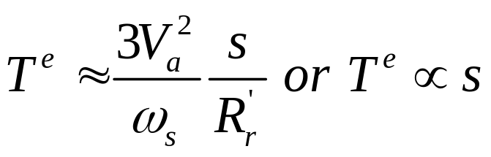




Three-phase induction machines
Expression for T^{e} in terms of V_{a}
  s small
  s large value
Trịnh Hoàng Hơn
ICA Lab

Slide 28

Three-phase induction machines
Trịnh Hoàng Hơn
ICA Lab

Slide 29





Three-phase induction machines
(19)
Expression for
T^{e} in terms of V_{a}
Trịnh Hoàng Hơn
ICA Lab

Slide 30
Three-phase induction machines
(19)
Expression for
T^{e} in terms of V_{a}
Trịnh Hoàng Hơn
ICA Lab

Slide 31

Example
Three phase Induction motor: 4-poles, 60Hz
  Parameters per phase
  Source voltage
Questions
  At n=1746 rpm
    Stator’s current
    Magnetizing current
    Rotor’s current
Trịnh Hoàng Hơn
ICA Lab

Slide 32



Example
A
  Calculate:
  Find
Solutions
  Option 1: Using exact circuit
    Synchronous speed: Ns=1800rpm
    Slip term: s=0.03
    Rotor’s impedance: 16.6667 + 4i
    Equivalent impedance at AB: 7.8084 + 8.7559i
    Input impedance: 7.8084 +13.7559i
B
Trịnh Hoàng Hơn
ICA Lab

Slide 33
Example
    Stator current: 3.1209 - 5.4980i =6.3221∠-60.4188
    Voltage between A and B:
        72.5098 -15.6047i= 74.1699 ∠-12.1453
    Magnetizing current: -0.78- 3.6i=3.7 ∠ -102.15
    Rotor‘s current: 3.9 - 1.87i = 4.33 ∠-25.64
Trịnh Hoàng Hơn
ICA Lab

Slide 34





A
Option 2: Using
Thevenin equivalent
circuit
B
Trịnh Hoàng Hơn
ICA Lab

Slide 35

Example
Option 2: Using Thevenin equivalent circuit
    Thevenin impedance: z_{Th}= 4.0000j= R_{Th}+ jX_{Th}
    Ideal Magnetizing current: i₀ 0.0000 - 4.0000i
    Thevenin voltage: v_{Th}: 80.0000
    Rotor current: i_{r}= 3.9012-1.8726i=4.3273∠-25.6410
    Stator current:is=3.9012-5.8726i=7.0503 ∠-56.4037
    Slip term at maximum torque: s_{mT}= 0.0625
    Maximum torque: T_{max}= 6.3667
    Starting torque: T_{sart}= 0.7927
Trịnh Hoàng Hơn
ICA Lab

Slide 36

Torque – velocity characteristic
Trịnh Hoàng Hơn
ICA Lab

Slide 37
Example
Option 3: Using Approximate equivalent circuit
    Approximate Magnetizing current
      i₀: i0: 0.0000 - 5.0000i
    Rotor current: i_{r}= 4.6454 -2.5085i=5.2794∠-28.369
    Stator current: i_{s}=4.6454 -7.5085i=8.8294 ∠-58.2556
    Slip term at maximum torque: s_{mT}= 0.0556
    Maximum torque: T_{max}= 8.8426
    Starting torque: T_{sart}= 0.9795
Trịnh Hoàng Hơn
ICA Lab

Slide 38

Comparison
Trịnh Hoàng Hơn
ICA Lab

Slide 39
Bài tập ôn tập khóa 201
  7.4; 7.11; 7.13; 7.22; 7.23
Trịnh Hoàng Hơn
ICA Lab

Slide 40

Trịnh Hoàng Hơn
ICA Lab

Slide 41



Slide 42



Slide 44


Slide 46


